Slide 1
Data Integration (Joining)

Slide 2
Tables
… are just like sheets in an excel workbook
… have rows (entities) and columns (fields/features)

Slide 3
Why do we split data up into separate tables?
Example: supervisors and their projects
Let’s first create an excel worksheet table to represent projects and their managers.
So why don’t we just use a single large table?
Create, Read, Update, Delete (CRUD)
Let’s split the supervisors and projects into separate tables…

Slide 4
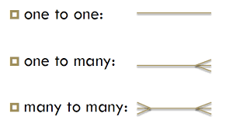
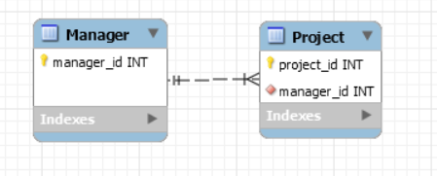
Tables are related to each other
We describe the relationships between tables like this:
“One-to-one”
“One-to-many”
“Many-to-many”
What is the relationship between managers and projects?
Example: “A manager supervises many projects, but each project is only supervised by at most one manager.”
So, the relationship is “one-to-many”

Slide 5
Tables that are related to each other have “keys” linking them
Every table has a “primary key” – or a column (or set of columns) uniquely identifying a row
A table may have “foreign key(s)”, with a value linking a given row to a row on a “foreign” table.
Exercise: you have two tables with a “one-to-many” relationship. You have to pick a table to put the foreign key in. Which table do you put it in?
Create two separate sheets to store your “manager” and “Project” information.

Slide 6
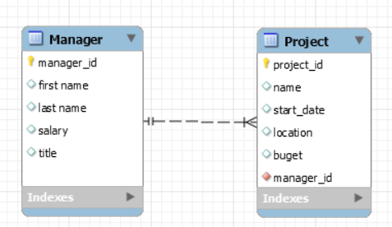
“What are the names of all projects that Bob manages?
To do this in Alteryx, use the “Join” tool. Let’s look at its sample workflow. Then we’ll import our sample sheets.

Slide 7
Joins and Unjoins in Alteryx
Three types:
Inner
Both sides have to match
Only those records returned
Left Unjoin
Show records (and their attributes) that only exist in left table
Right Unjoin
Show records (and their attributes) that only exist in right table
But what if you want more than one “shaded section” at once?
Source for images: http://help.alteryx.com/9.5/Join.htm

Slide 8
Outer Joins in Alteryx
Three types:
Left Outer Join
All records from left table + all records in right table that join with the left.
Or, in alteryx speak: Inner join + left unjoin
Right Outer Join
All records from right table +all records in the left table that join with the right.
In Alteryx speak: Inner join + right unjoin
Full Outer Join
Everything from both tables
Alteryx speak: Inner join + left unjoin + right jnjoin
Source for images: http://help.alteryx.com/9.5/Join.htm

Slide 9

Let’s practice
Use “Text input” tools to “import” the sheets that you have created for the “manager” – “project” exercise
Make sure you have at least one project that doesn’t have a supervisor
Use a Join tool plus a Union tool to join the tables and have a list of all projects with their managers, including projects that don’t have a manager

Slide 10

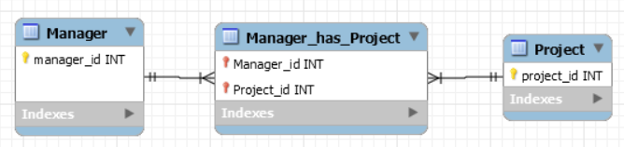
You cannot directly implement a “many-to-many” relationship
Consider if a project could have many supervisors, and a supervisor could have many projects. Which table would you put the foreign key(s) in?
To model this scenario, we create an “association” table, converting a “many-to-many” relationship into two “one-to-many” relationships.
The “primary key” of the association table is comprised of two fields, which are each foreign keys linking to different tables.
Manager
Project

Slide 11
Examine the classic models schema, and let’s join something…
https://richardtwatson.com/dm6e/images/general/ClassicModels.png

Slide 12
One more practice – with slum lords
Download this file
It has three sheets (tables):
slumlord_names
slum
slum_improvement
Keep in mind:
Not all slumlords have slums
Not all slums have slumlords
Join all the tables and create one “super table”

Slide 13
If time, practice with modeling “classes”

